Slide 1

Interactive Sales Dashboard

Slide 2
Sales Performance Overview
Equip business stakeholders with a clear, real-time view of sales performance—empowering informed and strategic decisions.
Enables proactive, data-driven action.
Provides a unified view of sales, profit, customer behavior, and product performance.
Helps identify both growth opportunities and areas needing attention.
Key Metrics (Current Snapshot):
• Total Sales: $2.30M
• Total Profit: $290K
• Units Sold: 38K
• Avg. Discount: 15.6%
• Filter Capability: Dynamic filtering by Order Date for time-based performance trends.
Category-wise Sales Breakdown:
• Technology: 36.4%
• Furniture: 32.3%
• Office Supplies: 31.3%
2

Slide 3
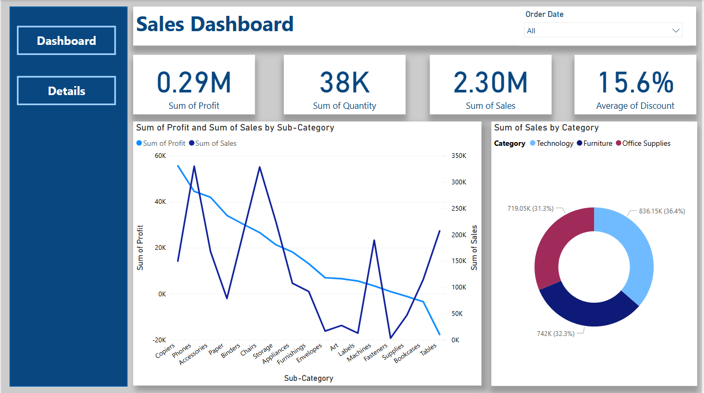

Slide 4
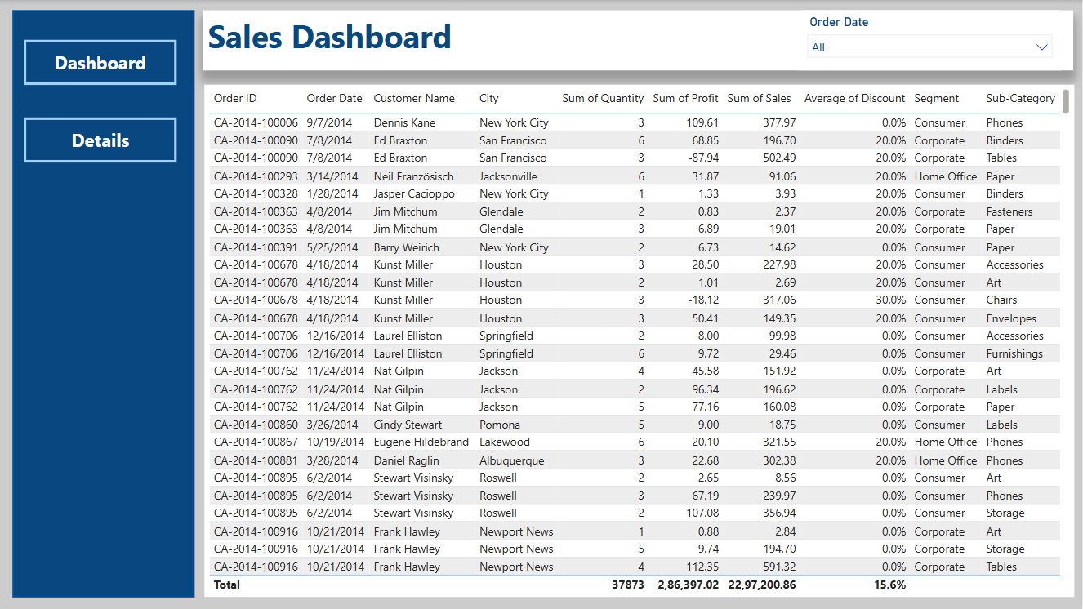

Slide 5
Dashboard Summary
Interactive Navigation:
- Seamless toggle between Dashboard and Details view for high-level and granular insights.
Dynamic Filtering:
- Built-in Order Date filter allows users to view data by specific time periods to analyze seasonal trends or campaign impacts.
Real-Time KPIs:
- Key performance indicators (KPIs) such as Total Sales, Profit, Quantity Sold, and Average Discount are updated instantly with filters.
Visual Analytics:
- Line & Bar Chart to compare Sales vs Profit across sub-categories.
- Donut Chart to visualize sales distribution by Product Category.
Detailed Data Table:
- Drill-down into individual transactions with customer name, city, sub-category, segment, discount, and sales/profit data.
5

Slide 6
Thank You

